Slide 1
Data Structures & Algorithms (DSE2101)

Slide 2
Algorithm Complexity
Suppose X is an algorithm and n is the size of input data, the time and space used by the algorithm X are the two main factors, which decide the efficiency of X.
Time Factor − Time is measured by counting the number of key operations such as comparisons in the sorting algorithm.
Space Factor − Space is measured by counting the maximum memory space required by the algorithm.
The complexity of an algorithm f(n) gives the running time and/or the storage space required by the algorithm in terms of n as the size of input data.

Slide 3
Space complexity:
Space complexity of an algorithm represents the amount of memory space required by the algorithm in its life cycle. The space required by an algorithm is equal to the sum of the following two components −
A fixed part that is a space required to store certain data and variables, that are independent of the size of the problem. For example, simple variables and constants used, program size, etc.
A variable part is a space required by variables; whose size depends on the size of the problem. For example, dynamic memory allocation, recursion stack space, etc.

Slide 4
Space complexity:
S(P) of any algorithm P is
S(P) = C + SP(I)
where C is the fixed part and S(I) is the variable part of the algorithm, which depends on instance characteristic I. Following is a simple example that tries to explain the concept −
Algorithm: SUM(A, B)
Step 1 - START
Step 2 - C ← A + B + 10
Step 3 - Stop
Here we have three variables A, B, and C and one constant. Hence S(P) = 1 + 3. Now, space depends on data types of given variables and constant types and it will be multiplied accordingly.

Slide 5
Time Complexity:
Time complexity of an algorithm represents the amount of time required by the algorithm to run to completion. Time requirements can be defined as a numerical function T(n), where T(n) can be measured as the number of steps, provided each step consumes constant time.
For example, addition of two n-bit integers takes n steps. Consequently, the total computational time is
T(n) = c ∗ n
where c is the time taken for the addition of two bits. Here, we observe that T(n) grows linearly as the input size increases.

Slide 6
Why asymptotic analysis?
Given two algorithms for a task, how do we find out which one is better? One naive way of doing this is – implement both the algorithms and run the two programs on your computer for different inputs and see which one takes less time.
There are many problems with this approach for analysis of algorithms.
1) It might be possible that for some inputs, first algorithm performs better than the second. And for some inputs second performs better.
2) It might also be possible that for some inputs, first algorithm perform better on one machine and the second works better on other machine for some other inputs.
Asymptotic Analysis is the big idea that handles above issues in analyzing algorithms. In Asymptotic Analysis, we evaluate the performance of an algorithm in terms of input size (we don’t measure the actual running time). We calculate, how the time (or space) taken by an algorithm increases with the input size.

Slide 7
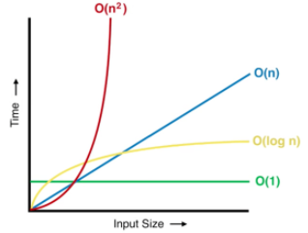
What is it?
Asymptotic analysis is used for analyzing algorithms in terms of time and space. We evaluate the performance of algorithm with respect to its input size(n).
We actually do not compute actual time taken or memory occupied by algorithm, we just analyze how the time or space taken by algorithm changes with increase in input size.
The main idea of asymptotic analysis is to have a measure of efficiency of algorithms that doesn’t depend on machine specific constants and doesn’t require algorithms to be implemented and time taken by programs to be compared.

Slide 8
Worst, Average and Best cases…
We have three cases to analyze and algorithm:
Worst case(usually done)- The maximum time taken by algo to solve a particular problem. In the worst-case analysis, we calculate upper bound on running time of an algorithm. We must know the case that causes maximum number of operations to be executed.
Average case(sometimes done)- The average time taken by algo to solve a particular problem. In average case analysis, we take all possible inputs and calculate computing time for all of the inputs. Sum all the calculated values and divide the sum by total number of inputs. We must know (or predict) distribution of cases.
Best case(bogus)- The best/minimum time taken by algo to solve a particular problem. In the best-case analysis, we calculate lower bound on running time of an algorithm. We must know the case that causes minimum number of operations to be executed.

Slide 9
Asymptotic notations are mathematical tools to represent time complexity of algorithms for asymptotic analysis.
The following 3 asymptotic notations are mostly used to represent time complexity of algorithms.
O − Big Oh
Ω − Big omega
θ − Big theta

Slide 10
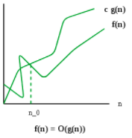
O − Big Oh Notation
Asymptotic Upper Bound
‘O’ (Big Oh) is the most commonly used notation.
The Big O notation defines an upper bound of an algorithm, it bounds a function only from above.
A function f(n) can be represented is the order of g(n) that is f(n) = O(g(n)), if there exists a value of positive integer n as n₀ and a positive constant c such that
f(n) ≤ c.g(n) for n > no in all cases
Hence, function g(n) is an upper bound for function f(n), as g(n) grows faster than f(n)

Slide 11
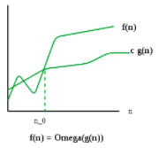
Ω − Big omega
Asymptotic Lower Bound
Ω Notation is the least used notation because best-case performance of an algorithm is generally not useful
The Ω notation defines a lower bound of an algorithm, it bounds a function only from below.
We say that f(n) = Ω(g(n)) when there exists constant c that
f(n) ≥ c.g(n)
for all sufficiently large value of n. Here n is positive integer. This means function g is lower bound for function f, after a certain value of n, f will never go below g.

Slide 12
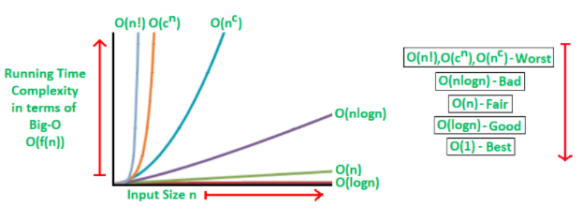
It may be noted that an algorithm that takes O(n) time is better than that takes O(n²) time. If O(n) is upper bound of an algorithm then O(n²), O(n³), O(n⁴) etc. would also be upper bounds.
If Ω(n³) is lower bound of algorithm then Ω(n²), Ω(n), Ω(1) etc. would also be lower bounds.
Think Upon..

Slide 13
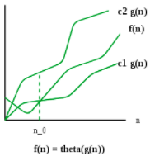
θ − Big theta
It bounds a functions from above and below, so it defines exact asymptotic behavior.
We say that f(n) = θ(g(n)) when there exists constant c1 and c2 that
c1.g(n) ≤ f(n) ≤ c2.g(n)
for all sufficiently large value of n. Here n is positive integer. This means function g is tight bound for function f, after a certain value of n.

Slide 14
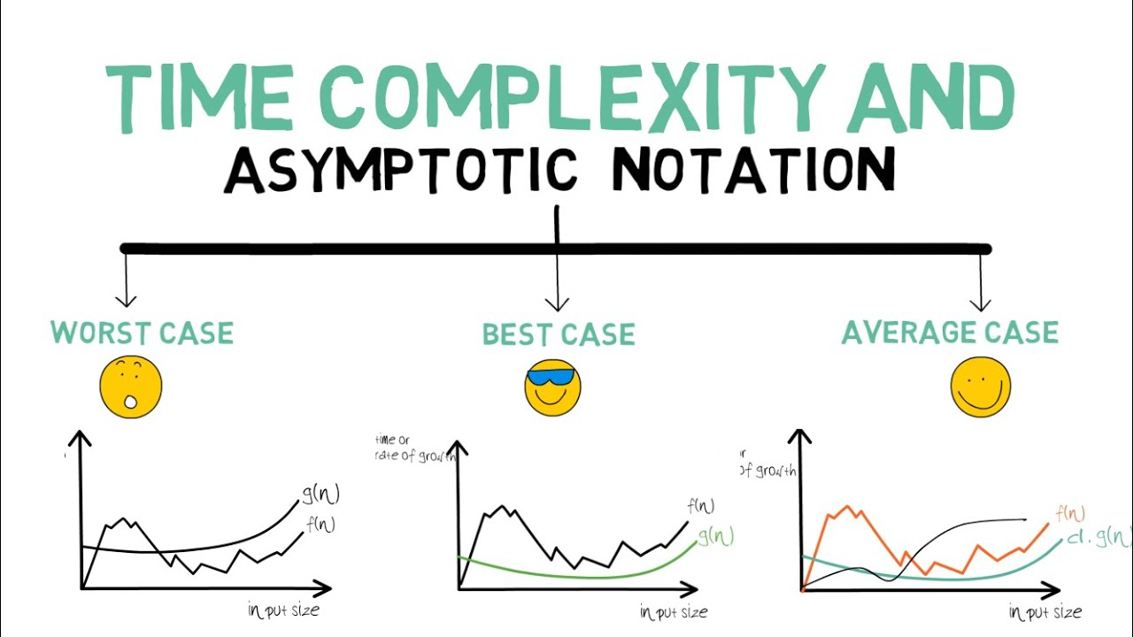

Slide 15
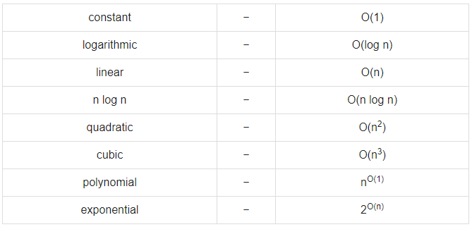
Some common Asymptotic Analysis

Slide 16
Questions?

